Slide 1
The while Loop

Slide 2

The while Loop
Executes a block of code repeatedly
while loop repeatedly executes an indented block of statements
As long as a certain condition is met
Form
Continuation condition is a boolean expression

Slide 3
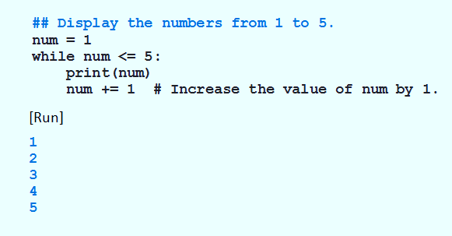
The while Loop
Example 1: Program displays 1 – 5, after loop terminates, num will be 6

Slide 4
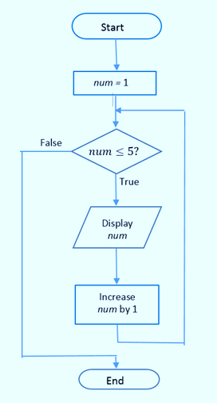
The while Loop
FIGURE 3.22 Flowchart for Example 1.

Slide 5
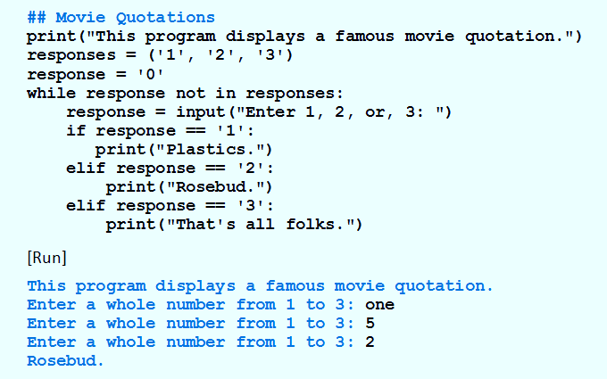
The while Loop
Example 2: Input validation.

Slide 6
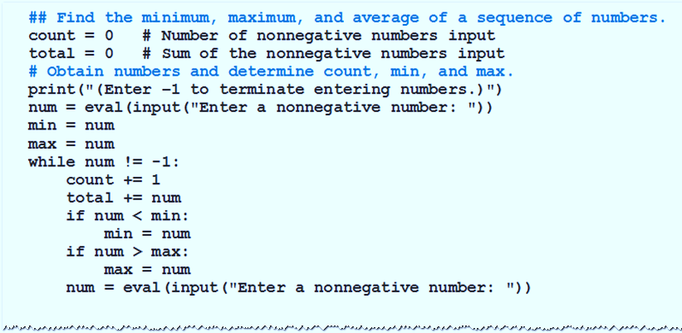
The while Loop
Example 3: Find min, max, average.

Slide 7
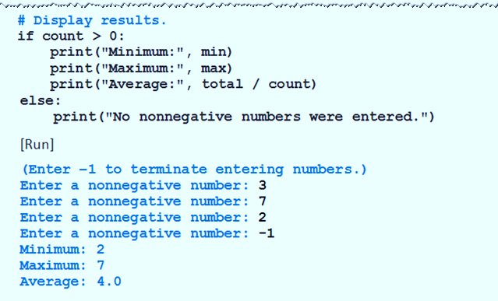
The while Loop
Example 3: Find min, max, average.

Slide 8
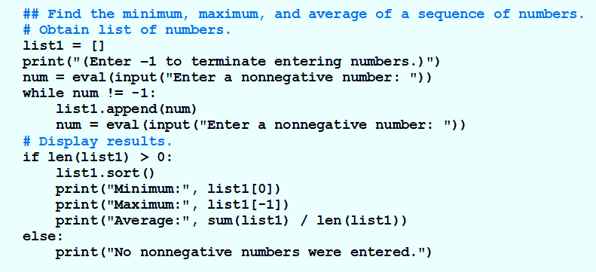
The while Loop
Example 4: Stores the numbers in a list, and then uses list methods and functions to determine the requested values.

Slide 9
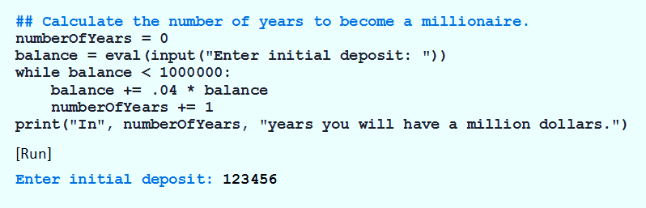
The while Loop
Example 5: Determines when bank deposit reaches one million dollars

Slide 10
The break Statement
Causes an exit from anywhere in the body of a loop
When break is executed
Loop immediately terminates
Break statements usually occur in if statements

Slide 11
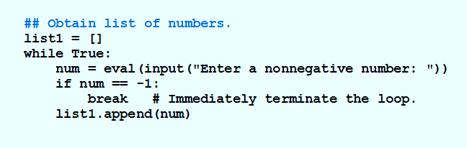
The break Statement
Example 6: Program uses break to avoid two input statements.

Slide 12
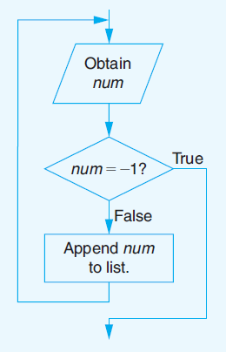
The break Statement
FIGURE 3.23 Flowchart for Example 6

Slide 13
The continue Statement
When continue executed in a while loop
Current iteration of the loop terminates
Execution returns to the loop’s header
Usually appear inside if statements.

Slide 14
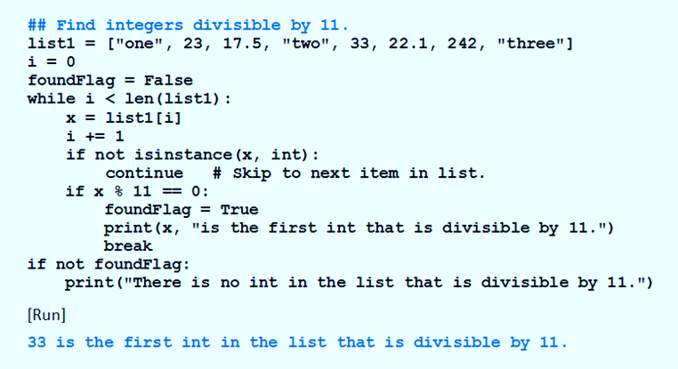
The continue Statement
Example 7: Searches a list for the first int object that is divisible by 11.

Slide 15
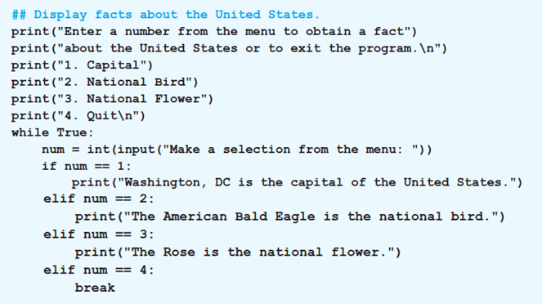
Creating a Menu
Example 8: Uses a menu to obtain facts about the United States.

Slide 16
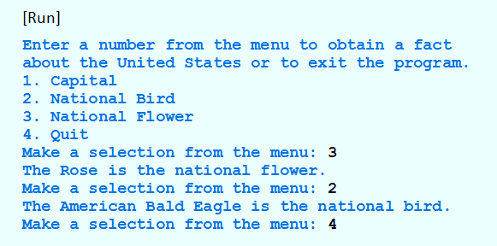
The continue Statement
Example 8: Uses a menu to obtain facts about the United States.

Slide 17
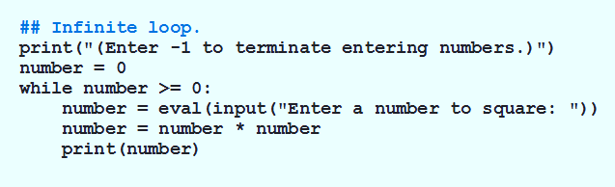
Infinite Loops
Example 9: Condition number >= 0 always true.

Slide 18
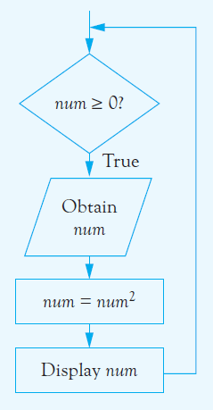
Infinite Loops
FIGURE 3.24 Program Containing an Infinite Loop.

Slide 19
END

